Slide 1
Binomial Queues
CMSC420 0101
Spring 2019

Slide 2
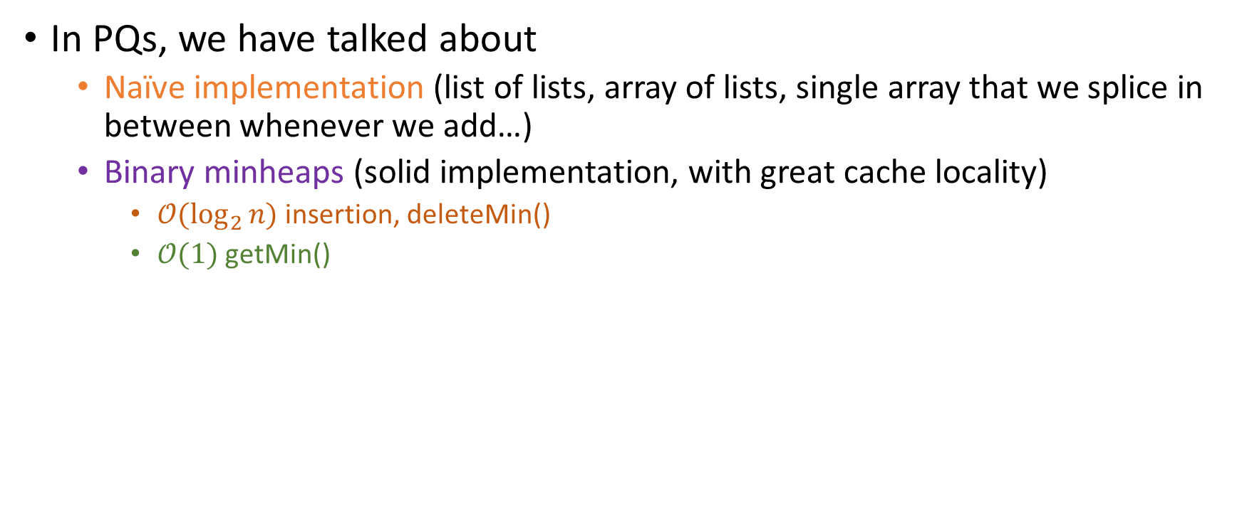
Additional Priority Queue operations
In PQs, we have talked about
Naïve implementation (list of lists, array of lists, single array that we splice in between whenever we add…)
Binary minheaps (solid implementation, with great cache locality)
$𝒪(\log_{2}{n)}$ insertion, deleteMin()
$𝒪(1)$ getMin()

Slide 3
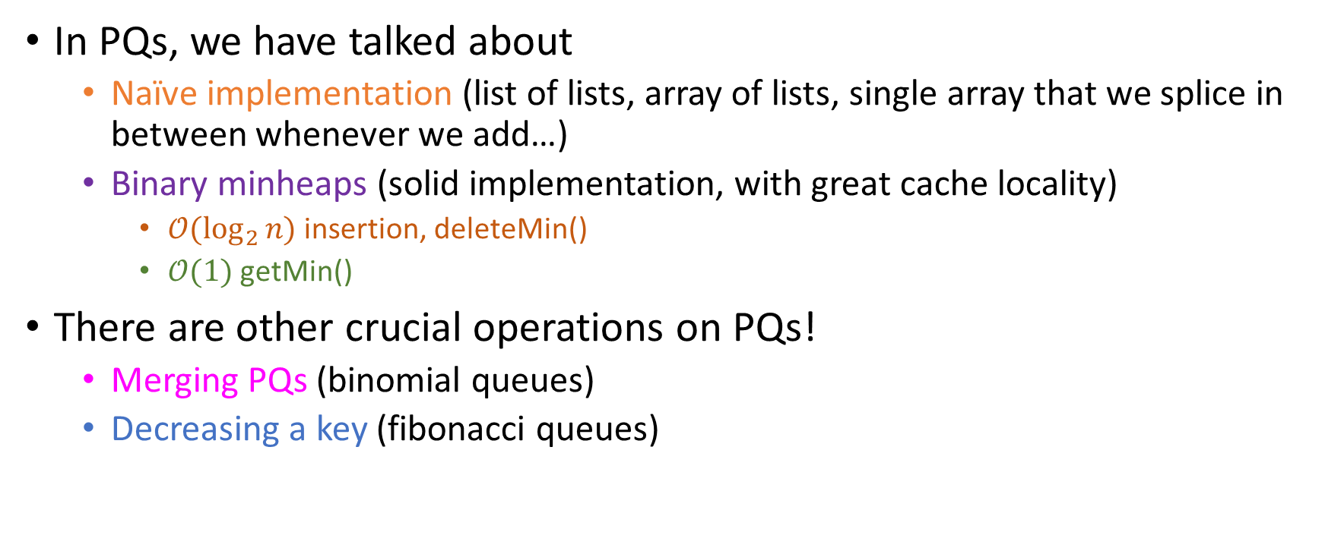
Additional Priority Queue operations
In PQs, we have talked about
Naïve implementation (list of lists, array of lists, single array that we splice in between whenever we add…)
Binary minheaps (solid implementation, with great cache locality)
$𝒪(\log_{2}{n)}$ insertion, deleteMin()
$𝒪(1)$ getMin()
There are other crucial operations on PQs!
Merging PQs (binomial queues)
Decreasing a key (fibonacci queues)

Slide 4
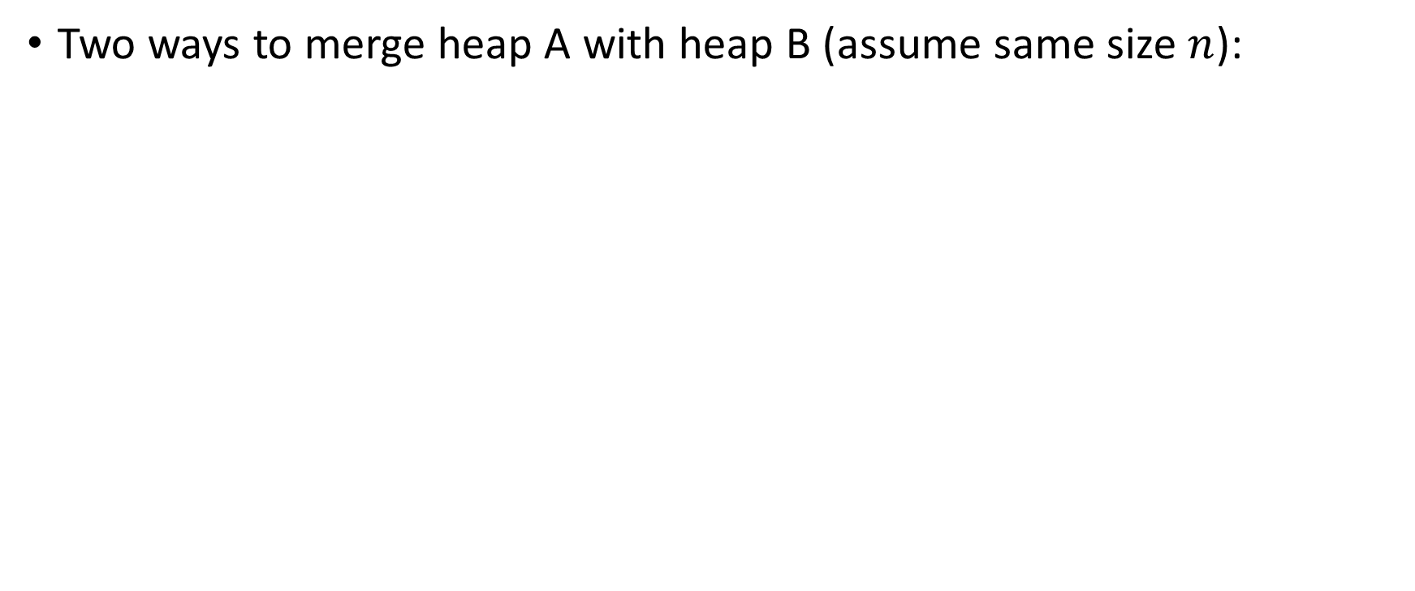
Merging heaps
Two ways to merge heap A with heap B (assume same size $n$):

Slide 5
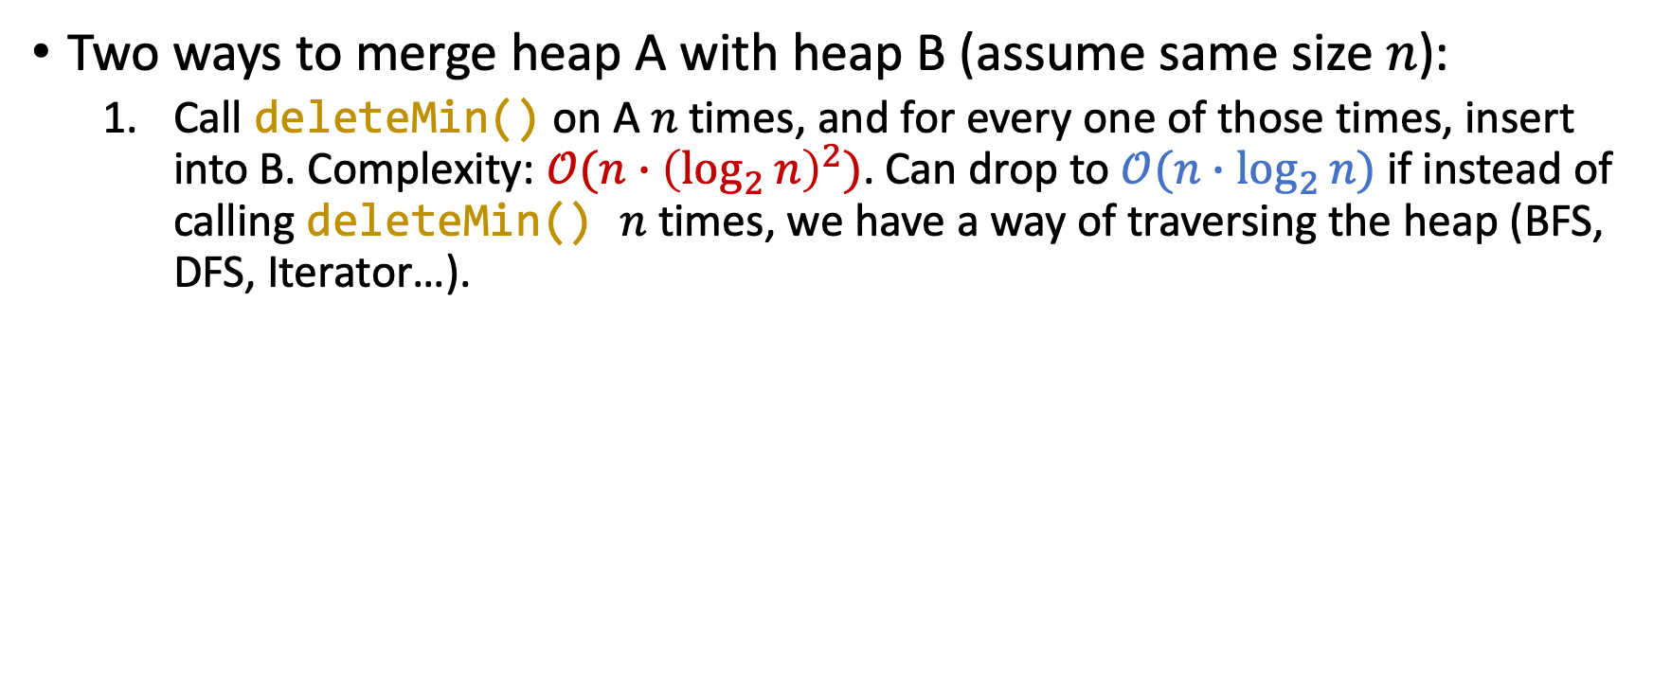
Merging heaps
Two ways to merge heap A with heap B (assume same size $n$):
Call deleteMin() on A $n$ times, and for every one of those times, insert into B. Complexity: $𝒪(n∙{\left(\log_{2}{n}\right)}^{2})$. Can drop to $𝒪(n∙\log_{2}{n})$ if instead of calling deleteMin() $n$ times, we have a way of traversing the heap (BFS, DFS, Iterator…).

Slide 6
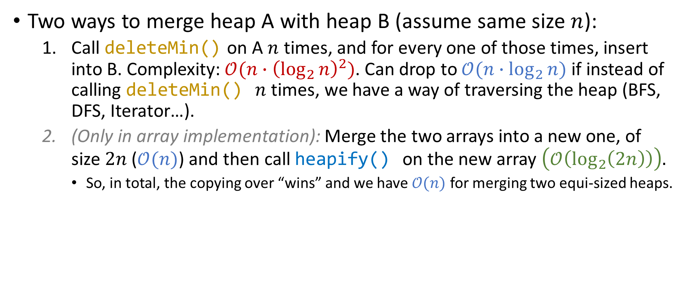
Merging heaps
Two ways to merge heap A with heap B (assume same size $n$):
Call deleteMin() on A $n$ times, and for every one of those times, insert into B. Complexity: $𝒪(n∙{\left(\log_{2}{n}\right)}^{2})$. Can drop to $𝒪(n∙\log_{2}{n})$ if instead of calling deleteMin() $n$ times, we have a way of traversing the heap (BFS, DFS, Iterator…).
(Only in array implementation): Merge the two arrays into a new one, of size $2n$ ($𝒪(n)$) and then call heapify() on the new array $\left(𝒪\left(\log_{2}\left(2n\right)\right)\right).$
So, in total, the copying over “wins” and we have $𝒪(n)$ for merging two equi-sized heaps.

Slide 7
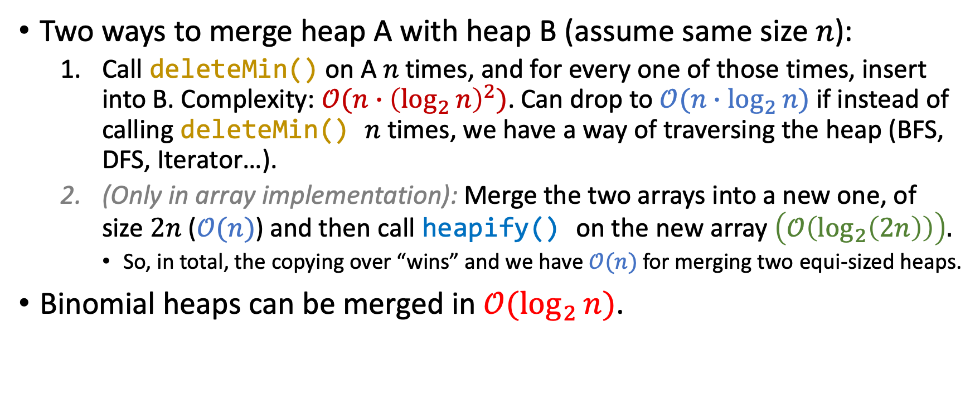
Merging heaps
Two ways to merge heap A with heap B (assume same size $n$):
Call deleteMin() on A $n$ times, and for every one of those times, insert into B. Complexity: $𝒪(n∙{\left(\log_{2}{n}\right)}^{2})$. Can drop to $𝒪(n∙\log_{2}{n})$ if instead of calling deleteMin() $n$ times, we have a way of traversing the heap (BFS, DFS, Iterator…).
(Only in array implementation): Merge the two arrays into a new one, of size $2n$ ($𝒪(n)$) and then call heapify() on the new array $\left(𝒪\left(\log_{2}\left(2n\right)\right)\right).$
So, in total, the copying over “wins” and we have $𝒪(n)$ for merging two equi-sized heaps.
Binomial heaps can be merged in $𝒪(\log_{2}{n})$.

Slide 8
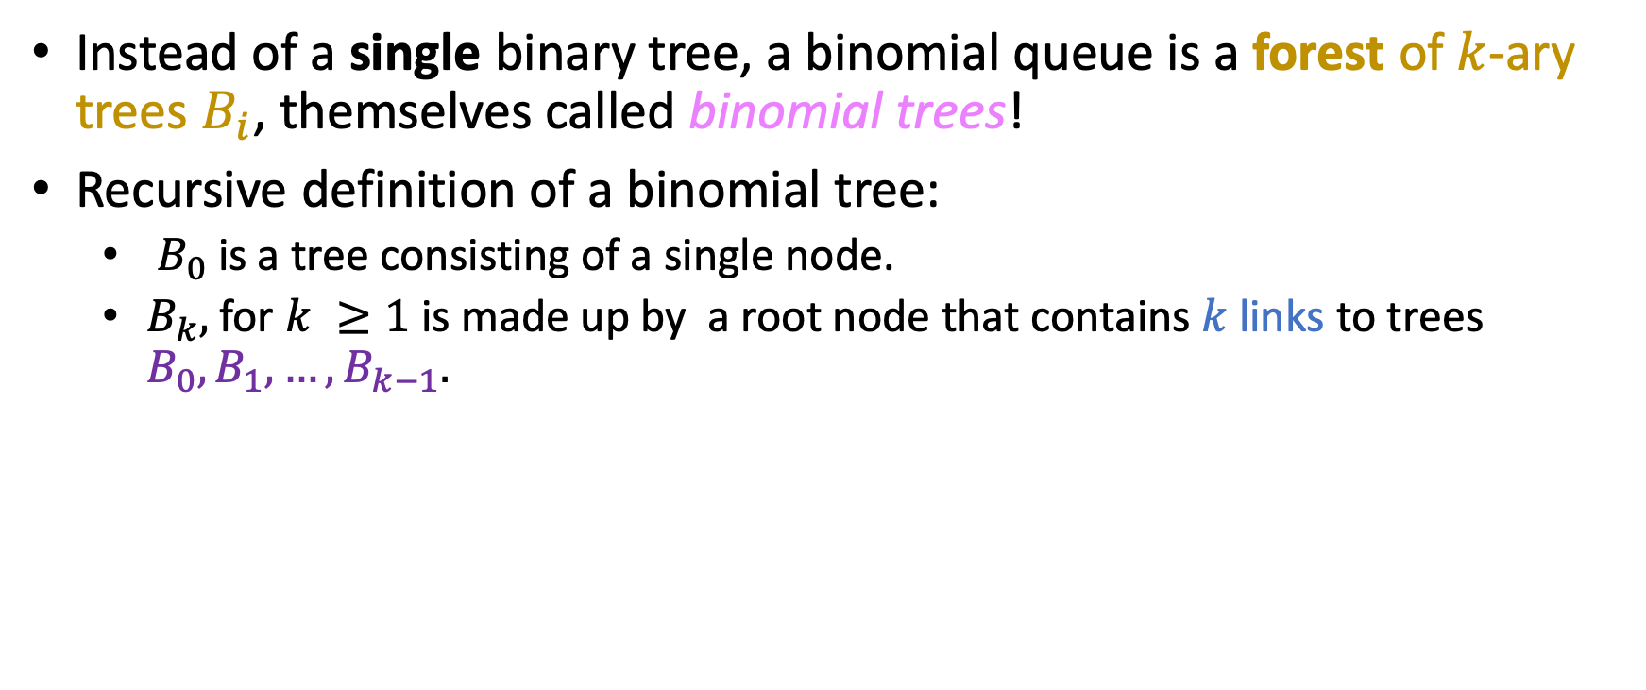
Binomial queue: basic structure
Instead of a single binary tree, a binomial queue is a forest of $k$-ary trees $B_{i}$, themselves called binomial trees!
Recursive definition of a binomial tree:
$B_{0}$ is a tree consisting of a single node.
$B_{k},$ for $k ≥1$ is made up by a root node that contains $k$ links to trees $B_{0}, B_{1},…, B_{k−1}.$

Slide 9
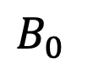
Binomial queue example
$$B_{0}$$

Slide 10
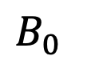
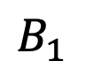
Binomial queue example
$$B_{0}$$
$$B_{1}$$

Slide 11
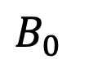
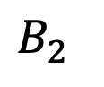
Binomial queue example
$$B_{0}$$
$$B_{1}$$
$$B_{2}$$

Slide 12
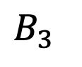
Binomial queue example
$$B_{0}$$
$$B_{1}$$
$$B_{2}$$
$$B_{3}$$

Slide 13
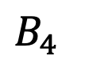
Binomial queue example
$$B_{0}$$
$$B_{1}$$
$$B_{2}$$
$$B_{3}$$
$$B_{4}$$

Slide 14
Binomial queue example
$$B_{0}$$
$$B_{1}$$
$$B_{2}$$
$$B_{3}$$
$$B_{4}$$
All those heap-ordered trees together (a forest) make up the binomial queue.

Slide 15
Binomial queue example
$$B_{0}$$
$$B_{1}$$
$$B_{2}$$
$$B_{3}$$
$$B_{4}$$
7
4
8
34
20
10
12
16
32
14
9
8
15
9
14
16
23
20
22
18
25
13
18
22
20
30
22
18
28
27
26
All those heap-ordered trees together (a forest) make up the binomial queue.

Slide 16
Binomial queue example
$$B_{0}$$
$$B_{1}$$
$$B_{2}$$
$$B_{3}$$
$$B_{4}$$
7
4
8
34
20
10
12
16
32
14
9
8
15
9
14
16
23
20
22
18
25
13
18
22
20
30
22
18
28
27
26
All those heap-ordered trees together (a forest) make up the binomial queue.
The roots are connected to each other through a list.

Slide 17
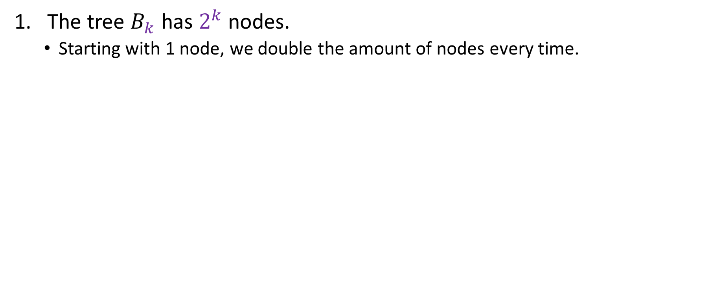
Some results
The tree $B_{k}$ has $2^{k}$ nodes.
Starting with 1 node, we double the amount of nodes every time.

Slide 18
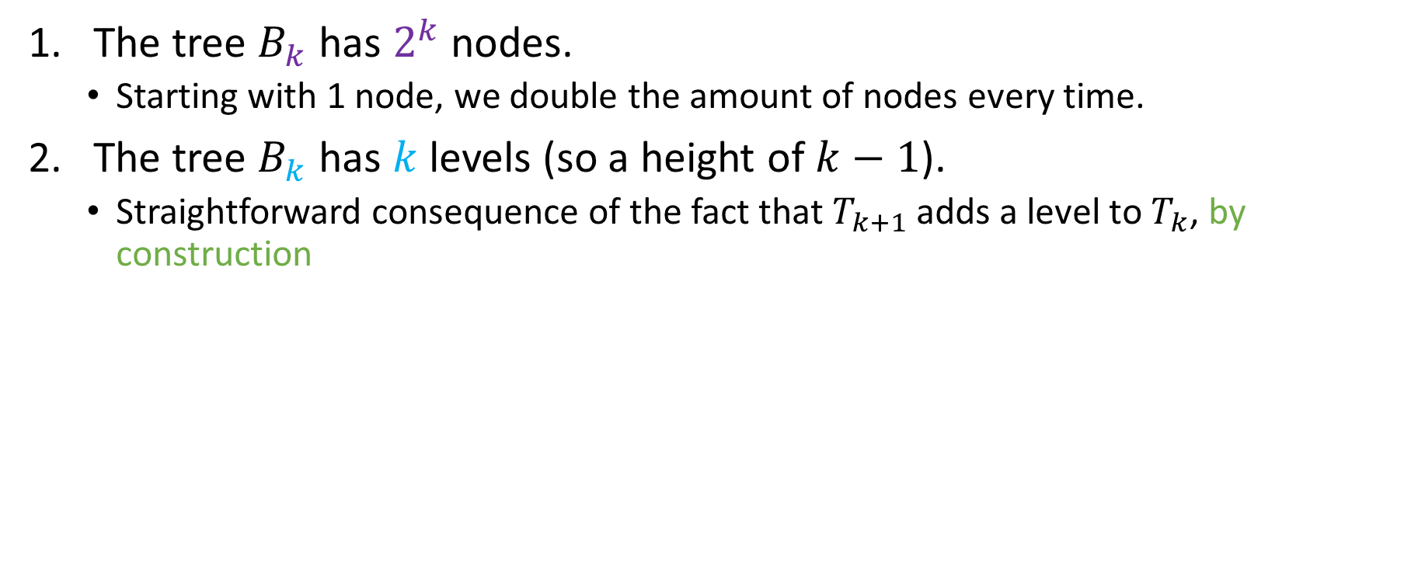
Some results
The tree $B_{k}$ has $2^{k}$ nodes.
Starting with 1 node, we double the amount of nodes every time.
The tree $B_{k}$ has $k$ levels (so a height of $k−1$).
Straightforward consequence of the fact that $T_{k+1}$ adds a level to $T_{k}$, by construction

Slide 19
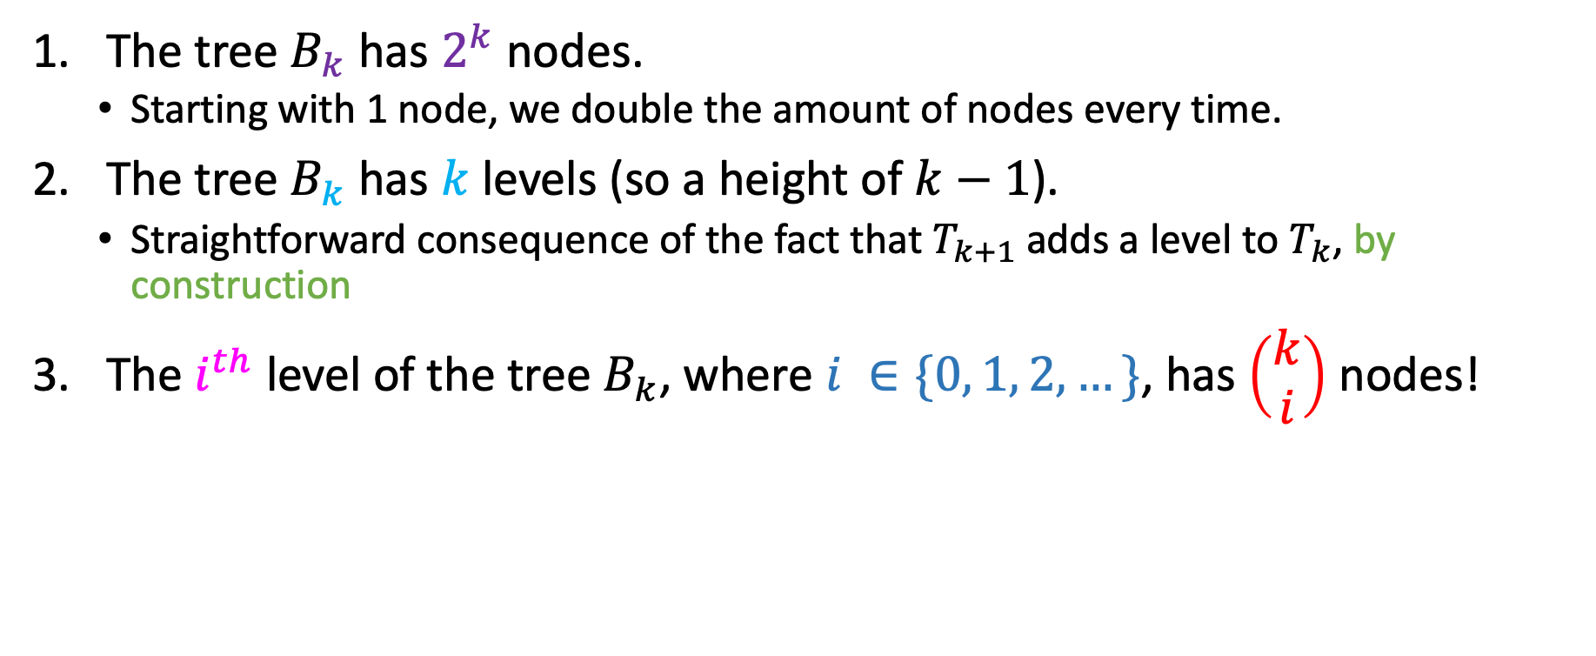
Some results
The tree $B_{k}$ has $2^{k}$ nodes.
Starting with 1 node, we double the amount of nodes every time.
The tree $B_{k}$ has $k$ levels (so a height of $k−1$).
Straightforward consequence of the fact that $T_{k+1}$ adds a level to $T_{k}$, by construction
The $i^{th}$ level of the tree $B_{k}$, where $i ∈\{0, 1, 2, …\}$, has $\left(\begin{aligned}k \\ i\end{aligned}\right)$ nodes!

Slide 20
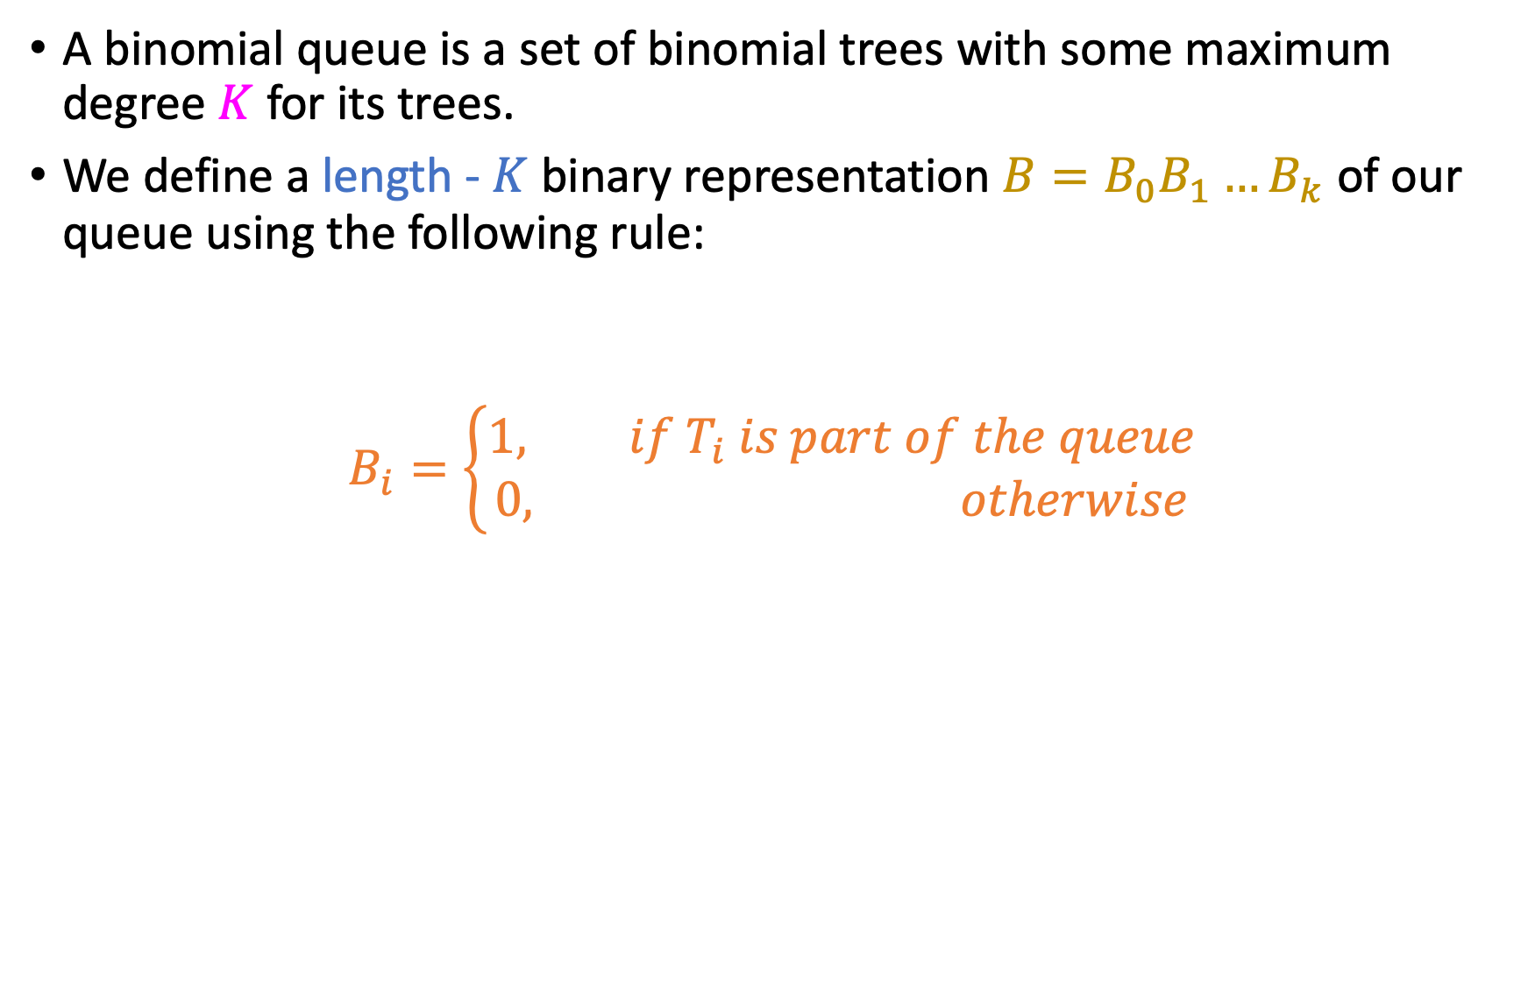
Binary representation of a binomial queue
A binomial queue is a set of binomial trees with some maximum degree $K$ for its trees.
We define a length - $K$ binary representation $B=B_{0}B_{1}…B_{k}$ of our queue using the following rule:
$$B_{i}=\left\{\begin{aligned}1, if T_{i} is part of the queue \\ 0, otherwise\end{aligned}\right.$$

Slide 21
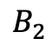
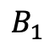
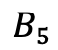
Binary representation example
$$B_{1}$$
$$B_{2}$$
$$B_{5}$$

Slide 22
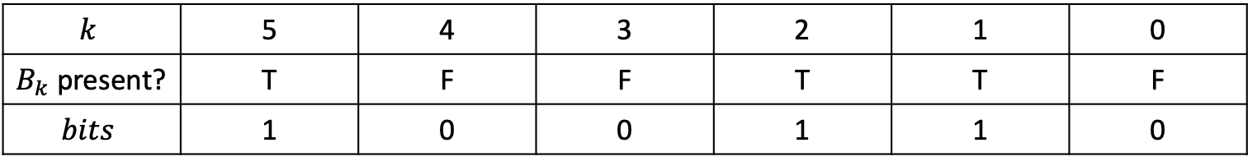
Binary representation example
$$B_{1}$$
$$B_{2}$$
$$B_{5}$$
$$k$$ | 5 | 4 | 3 | 2 | 1 | 0
$B_{k}$ present? | T | F | F | T | T | F
$$bits$$ | 1 | 0 | 0 | 1 | 1 | 0

Slide 23
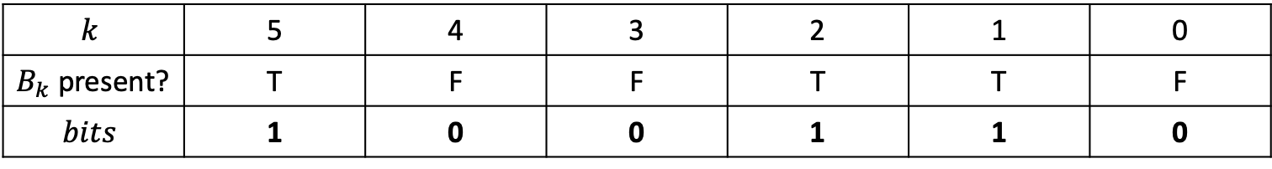
Binary representation example
$$B_{1}$$
$$B_{2}$$
$$B_{5}$$
$$k$$ | 5 | 4 | 3 | 2 | 1 | 0
$B_{k}$ present? | T | F | F | T | T | F
$$bits$$ | 1 | 0 | 0 | 1 | 1 | 0

Slide 24
Binary representation example
$$B_{1}$$
$$B_{2}$$
$$B_{5}$$
$$k$$ | 5 | 4 | 3 | 2 | 1 | 0
$B_{k}$ present? | T | F | F | T | T | F
$$bits$$ | 1 | 0 | 0 | 1 | 1 | 0
Another result: A binomial queue of size $n$ has $\left\lceil \log_{2}{n}\right\rceil$ trees.

Slide 25
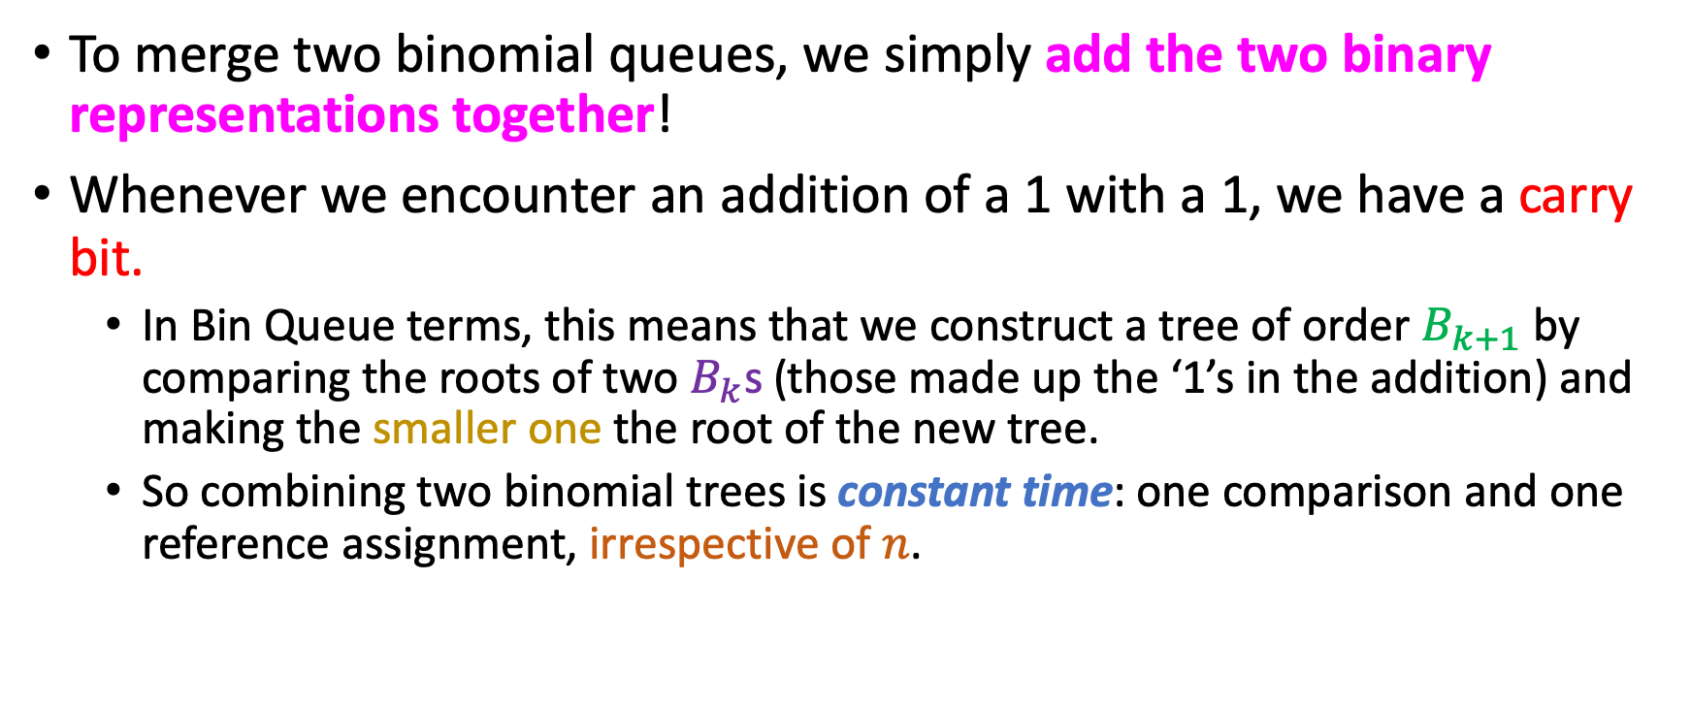
Merging binomial queues
To merge two binomial queues, we simply add the two binary representations together!
Whenever we encounter an addition of a 1 with a 1, we have a carry bit.
In Bin Queue terms, this means that we construct a tree of order $B_{k+1}$ by comparing the roots of two $B_{k}$s (those made up the ‘1’s in the addition) and making the smaller one the root of the new tree.
So combining two binomial trees is constant time: one comparison and one reference assignment, irrespective of $n$.

Slide 26
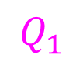
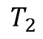
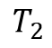
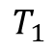
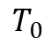
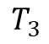
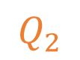
Merging example
$$Q_{1}$$
$$Q_{2}$$
$$T_{2}$$
$$T_{3}$$
$$T_{0}$$
$$T_{1}$$
$$T_{2}$$
7
10
6
5
3
14
24
Merge
14
9
17
19
18
10
7
18
23
23
26
20

Slide 27
Merging example
$$Q_{1}$$
$$Q_{2}$$
$$T_{2}$$
$$T_{3}$$
$$T_{0}$$
$$T_{1}$$
$$T_{2}$$
7
10
6
5
3
14
24
Merge
14
9
17
19
18
10
7
18
23
23
26
20
Since the highest rank tree is 3, we have two 4-bit representations to add.

Slide 28
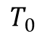
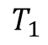
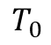
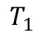
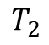
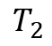
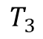
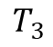
Merging example
$$Q_{1}$$
$$Q_{2}$$
$$T_{2}$$
$$T_{3}$$
$$T_{0}$$
$$T_{1}$$
$$T_{2}$$
7
10
6
5
3
14
24
Merge
14
9
17
19
18
10
7
18
23
23
26
20
1 1 0 0
0 1 1 1
$$T_{3}$$
$$T_{2}$$
$$T_{1}$$
$$T_{0}$$
$$T_{3}$$
$$T_{2}$$
$$T_{1}$$
$$T_{0}$$

Slide 29
Merging example
$$Q_{1}$$
$$Q_{2}$$
$$T_{2}$$
$$T_{3}$$
$$T_{0}$$
$$T_{1}$$
$$T_{2}$$
7
10
6
5
3
14
24
Merge
14
9
17
19
18
10
7
18
23
23
26
1 1 0 0
20
0 1 1 1
1 0 0 1 1

Slide 30
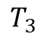
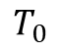
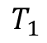
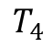
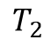
Merging example
$$Q_{1}$$
$$Q_{2}$$
$$T_{2}$$
$$T_{3}$$
$$T_{0}$$
$$T_{1}$$
$$T_{2}$$
7
10
6
5
3
14
24
Merge
14
9
17
19
18
10
7
18
23
23
26
1 1 0 0
20
0 1 1 1
1 0 0 1 1
$$T_{4}$$
$$T_{3}$$
$$T_{2}$$
$$T_{1}$$
$$T_{0}$$

Slide 31
Merging example
$$Q_{1}$$
$$Q_{2}$$
$$T_{2}$$
$$T_{3}$$
$$T_{0}$$
$$T_{1}$$
$$T_{2}$$
7
10
6
5
3
14
24
Merge
14
9
17
19
18
10
7
18
23
23
26
Those trees have to stay, since they are in the result (and also don’t combine in any way…)
1 1 0 0
20
0 1 1 1
1 0 0 1 1
$$T_{4}$$
$$T_{3}$$
$$T_{2}$$
$$T_{1}$$
$$T_{0}$$

Slide 32
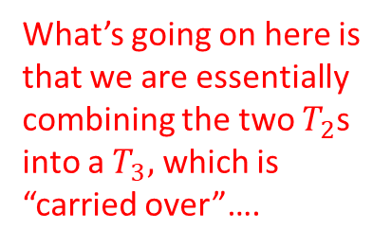
Merging example
$$T_{2}$$
$$T_{3}$$
$$T_{0}$$
$$T_{1}$$
$$T_{2}$$
7
10
6
5
3
14
14
9
17
19
24
18
10
7
18
1
23
23
26
What’s going on here is that we are essentially combining the two $T_{2}$s into a $T_{3},$ which is “carried over”….
1 1 0 0
20
0 1 1 1
1 0 0 1 1
$$T_{4}$$
$$T_{3}$$
$$T_{2}$$
$$T_{1}$$
$$T_{0}$$

Slide 33
Merging example
Compare roots to decide which one will be the new root….
$$T_{2}$$
$$T_{3}$$
$$T_{0}$$
$$T_{1}$$
$$T_{2}$$
7
10
6
5
3
14
14
9
17
19
24
18
10
7
18
1
23
23
26
What’s going on here is that we are essentially combining the two $T_{2}$s into a $T_{3},$ which is “carried over”….
1 1 0 0
20
0 1 1 1
1 0 0 1 1
$$T_{4}$$
$$T_{3}$$
$$T_{2}$$
$$T_{1}$$
$$T_{0}$$

Slide 34
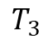
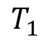
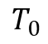
Merging example
$$T_{3}$$
$$T_{0}$$
$$T_{1}$$
$$T_{3}$$
10
6
5
3
14
17
19
24
18
10
7
7
18
1
23
26
14
9
20
1 1 0 0
23
0 1 1 1
1 0 0 1 1
$$T_{4}$$
$$T_{3}$$
$$T_{2}$$
$$T_{1}$$
$$T_{0}$$

Slide 35
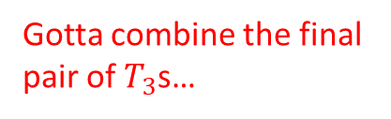
Merging example
$$T_{3}$$
$$T_{0}$$
$$T_{1}$$
$$T_{3}$$
10
6
5
3
14
17
19
24
18
10
7
7
18
1
23
26
14
9
20
1 1 0 0
Gotta combine the final pair of $T_{3}$s…
23
0 1 1 1
1 0 0 1 1
$$T_{4}$$
$$T_{3}$$
$$T_{2}$$
$$T_{1}$$
$$T_{0}$$

Slide 36
Merging example
Compare roots…
$$T_{3}$$
$$T_{0}$$
$$T_{1}$$
$$T_{3}$$
10
6
5
3
14
17
19
24
18
10
7
7
18
1
23
26
14
9
20
1 1 0 0
Gotta combine the final pair of $T_{3}$s…
23
0 1 1 1
1 0 0 1 1
$$T_{4}$$
$$T_{3}$$
$$T_{2}$$
$$T_{1}$$
$$T_{0}$$

Slide 37

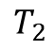







Merging example
$$T_{4}$$
And done!
3
$$T_{0}$$
$$T_{1}$$
6
5
10
7
7
18
14
24
18
14
9
20
10
17
19
26
23
26
1 0 0 1 1
$$T_{4}$$
$$T_{3}$$
$$T_{2}$$
$$T_{1}$$
$$T_{0}$$

Slide 38





Best scenario: no combines (carries)
$$T_{0}$$
$$T_{1}$$
6
5
$$T_{2}$$
$$T_{3}$$
7
10
10
14
$$T_{4}$$
3
24
Merge
14
9
17
19
18
10
7
7
18
23
23
26
14
24
18
14
9
20
01100
+ 10011 11111
17
19
23
26
26

Slide 39









Best scenario: no combines (carries)
$$T_{0}$$
$$T_{1}$$
$$T_{2}$$
$$T_{3}$$
6
5
7
10
14
$$T_{4}$$
3
10
14
9
17
19
24
18
10
7
7
18
23
23
26
14
24
18
14
9
20
1 1 1 1 1
17
19
23
26
$$T_{4}$$
$$T_{3}$$
$$T_{2}$$
$$T_{1}$$
$$T_{0}$$
26

Slide 40










Worst scenario: maximum combines (carries)
$$T_{0}$$
$$T_{1}$$
$$T_{0}$$
$$T_{1}$$
3
8
2
5
9
6
$$T_{2}$$
$$T_{2}$$
$$T_{3}$$
$$T_{3}$$
1
4
6
1
5
3
Merge
8
5
7
8
9
7
6
3
7
9
8
9
8
9
9
8
9
$$T_{4}$$
9
$$T_{4}$$
3
2
4
3
7
4
9
7
6
9
6
5
8
6
5
9
8
9
7
8
9
7
8
9
7
7
8
7
9
9
9
8

Slide 41
Worst scenario: maximum combines (carries)
$$T_{0}$$
$$T_{1}$$
$$T_{0}$$
$$T_{1}$$
3
8
2
5
9
6
$$T_{2}$$
$$T_{2}$$
$$T_{3}$$
$$T_{3}$$
1
4
6
1
5
3
Merge
8
5
7
8
9
7
6
3
7
9
8
9
8
9
9
8
9
$$T_{4}$$
1111 11111
+ 11111
111110
9
$$T_{4}$$
3
2
4
3
7
4
9
7
6
9
6
5
8
6
5
9
8
9
7
8
9
7
8
9
7
7
8
7
9
9
9
8

Slide 42

Worst scenario: maximum combines (carries)
$$T_{0}$$
$$T_{1}$$
$$T_{0}$$
$$T_{1}$$
3
8
2
5
9
6
$$T_{2}$$
$$T_{2}$$
$$T_{3}$$
$$T_{3}$$
1
4
6
1
5
3
8
5
7
8
9
7
6
3
7
9
8
9
8
9
9
8
9
$$T_{4}$$
1111 11111
+ 11111
111110
9
$$T_{4}$$
3
2
4
3
7
4
9
7
6
9
6
5
8
6
5
9
8
9
7
8
9
7
8
9
7
7
8
7
9
9
Gotta combine the two $T_{0}$s, which means that there will not be a $T_{0}$ in the final queue (LSB of sum is 0).
8
9

Slide 43

Worst scenario: maximum combines (carries)
$$T_{1}$$
$$T_{1}$$
$$T_{1}$$
8
2
5
9
3
6
$$T_{2}$$
$$T_{2}$$
$$T_{3}$$
$$T_{3}$$
1
4
6
1
5
3
8
5
7
8
9
7
6
3
7
9
8
9
8
9
9
8
9
$$T_{4}$$
1111 11111
+ 11111
111110
9
$$T_{4}$$
3
2
4
3
7
4
9
7
6
9
6
5
8
6
5
9
8
9
7
8
9
7
8
9
7
7
8
7
9
9
9
8

Slide 44

Worst scenario: maximum combines (carries)
$$T_{1}$$
$$T_{1}$$
$$T_{1}$$
8
2
5
9
3
6
$$T_{2}$$
$$T_{2}$$
$$T_{3}$$
$$T_{3}$$
1
4
6
1
5
Combine the two queues’ $T_{1}$s to produce a $T_{2}$ which we will carry over, while the previously produced $T_{1}$ persists in the output!
8
5
3
7
8
7
6
3
9
7
9
8
9
8
9
9
8
9
$$T_{4}$$
1111 11111
+ 11111
111110
9
$$T_{4}$$
3
2
4
3
7
4
9
7
6
9
6
5
8
6
5
9
8
9
7
8
9
7
8
9
7
7
8
7
9
9
9
8

Slide 45


Worst scenario: maximum combines (carries)
$$T_{1}$$
$$T_{2}$$
2
5
8
3
6
9
$$T_{2}$$
$$T_{2}$$
$$T_{3}$$
$$T_{3}$$
1
4
6
1
5
3
8
5
7
8
9
7
6
3
7
9
8
9
8
9
9
8
9
$$T_{4}$$
1111 11111
+ 11111
111110
9
$$T_{4}$$
3
2
4
3
7
4
9
7
6
9
6
5
8
6
5
9
8
9
7
8
9
7
8
9
7
7
8
7
9
9
9
8

Slide 46
Worst scenario: maximum combines (carries)
$$T_{1}$$
$$T_{2}$$
2
5
8
3
6
9
$$T_{2}$$
$$T_{2}$$
$$T_{3}$$
$$T_{3}$$
1
4
6
1
5
3
8
5
7
8
9
7
6
3
7
9
8
9
8
9
9
8
9
$$T_{4}$$
1111 11111
+ 11111
111110
9
$$T_{4}$$
3
2
4
3
7
4
9
7
6
9
6
5
8
6
5
9
8
9
7
8
9
7
8
9
7
7
8
7
9
9
9
8

Slide 47


Worst scenario: maximum combines (carries)
$$T_{1}$$
$$T_{2}$$
2
5
8
3
6
9
$$T_{3}$$
$$T_{3}$$
$$T_{3}$$
1
1
6
4
5
3
7
6
3
7
8
9
8
5
7
8
9
8
9
9
8
9
9
$$T_{4}$$
9
$$T_{4}$$
3
1111 11111
+ 11111
111110
2
4
3
7
4
9
7
6
9
6
5
8
6
5
9
8
9
7
8
9
7
8
9
7
7
8
7
9
9
9
8

Slide 48
Worst scenario: maximum combines (carries)
$$T_{1}$$
$$T_{2}$$
2
5
8
3
6
9
$$T_{3}$$
$$T_{3}$$
$$T_{3}$$
1
1
6
4
5
3
7
6
3
7
8
9
8
5
7
8
9
8
9
9
8
9
9
$$T_{4}$$
9
$$T_{4}$$
3
1111 11111
+ 11111
111110
2
4
3
7
4
9
7
6
9
6
5
8
6
5
9
8
9
7
8
9
7
8
9
7
7
8
7
9
9
9
8

Slide 49


Worst scenario: maximum combines (carries)
$$T_{1}$$
$$T_{2}$$
2
5
8
3
6
9
$$T_{4}$$
$$T_{3}$$
1
1
6
7
6
3
4
5
3
7
8
9
8
9
8
8
5
7
8
9
9
9
9
$$T_{4}$$
9
$$T_{4}$$
3
1111 11111
+ 11111
111110
2
4
3
7
4
9
7
6
9
6
5
8
6
5
9
8
9
7
8
9
7
8
9
7
7
8
7
9
9
9
8

Slide 50
Worst scenario: maximum combines (carries)
$$T_{1}$$
$$T_{2}$$
2
5
8
3
6
9
$$T_{4}$$
$$T_{3}$$
1
1
6
7
6
3
4
5
3
7
8
9
8
9
8
8
5
7
8
9
9
9
9
$$T_{4}$$
9
$$T_{4}$$
3
1111 11111
+ 11111
111110
2
4
3
7
4
9
7
6
9
6
5
8
6
5
9
8
9
7
8
9
7
8
9
7
7
8
7
9
9
9
8

Slide 51


Worst scenario: maximum combines (carries)
$$T_{1}$$
$$T_{2}$$
2
5
8
3
6
9
$$T_{4}$$
$$T_{3}$$
1
1
6
7
6
3
4
5
3
7
8
9
8
9
8
8
5
7
8
9
9
9
9
9
$$T_{5}$$
3
2
1111 11111
+ 11111
111110
3
4
7
6
9
7
4
9
6
5
8
8
9
6
5
9
8
9
7
7
8
9
7
7
8
7
9
9
9
8

Slide 52


Worst scenario: maximum combines (carries)
$$T_{1}$$
$$T_{2}$$
2
5
Had to merge 5 pairs of trees, so paid 5 unit costs.
Generally, for adding $k$-length bit vectors of all 1s (or, merging “full” binomial queues of rank $k$), we pay $k$ unit costs.
8
3
6
9
$$T_{4}$$
$$T_{3}$$
1
1
6
7
6
3
4
5
3
7
8
9
8
9
8
8
5
7
8
9
9
9
9
9
$$T_{5}$$
3
2
1111 11111
+ 11111
111110
3
4
7
6
9
7
4
9
6
5
8
8
9
6
5
9
8
9
7
7
8
9
7
7
8
7
9
9
9
8

Slide 53


How does $k$ grow?
Suppose we want to merge two binomial queues of the same maximum rank $r$. Both queues have $n$ keys total.

Slide 54

How does $k$ grow?
Suppose we want to merge two binomial queues of the same maximum rank $r$. Both queues have $n$ keys total.
How does $k$, the number of paid unit costs, grow as a function of $n$?

Slide 55



How does $k$ grow?
Suppose we want to merge two binomial queues of the same maximum rank $r$. Both queues have $n$ keys total.
How does $k$, the number of paid unit costs, grow as a function of $n$?
$$𝒪(n)$$
$$𝒪(1)$$
$$𝒪(\log_{2}{n})$$
Something else (what?)

Slide 56

How does $k$ grow?
Suppose we want to merge two binomial queues of the same maximum rank $r$. Both queues have $n$ keys total.
How does $k$, the number of paid unit costs, grow as a function of $n$?
$$𝒪(n)$$
$$𝒪(1)$$
$$𝒪(\log_{2}{n})$$
Something else (what?)
Worst-case scenario is two $r−$bit vectors of all 1s, which means that we will have to merge all same-rank pairs of trees.
But we already know that a Binomial Queue with $n$ elements has $⌈\log_{2}{n}⌉$ trees!

Slide 57
How does $k$ grow?
Suppose we want to merge two binomial queues of the same maximum rank $r$. Both queues have $n$ keys total.
How does $k$, the number of paid unit costs, grow as a function of $n$?
highest rank present = maximum payable cost!
$$𝒪(n)$$
$$𝒪(1)$$
$$𝒪(\log_{2}{n})$$
Something else (what?)
Worst-case scenario is two $r−$bit vectors of all 1s, which means that we will have to merge all same-rank pairs of trees.
But we already know that a Binomial Queue with $n$ elements has $⌈\log_{2}{n}⌉$ trees!

Slide 58


Merge these for me please!
6
10
5
8
15
12
8
10
20
7
7
10
14
23
11
14
9
17
19
16
22
$$Q_{2}$$
23
23
18
20
10
28
11
31
30
33
17
19
30
22
$$Q_{1}$$
22
45
40
18
33

Slide 59

Enqueue
To enqueue an element in a Binomial Queue, we simply make a $T_{0}$ out of it and merge this singleton queue with the rest of the queue.
Since we can generate up to $\log_{2}{n}$ pairs of trees that we should merge, enqueue() is also a ${𝒪(log}_{2}{n})$ operation .

Slide 60
Enqueuing example
10
8
10
5
14
17
19
16
22
7
Enqueue 8
23
18

Slide 61

Enqueuing example
10
8
10
5
14
17
19
16
22
Merge two $T_{0}$s into a $T_{1}$…
7
1
23
18
1 0 1 1 + 0 0 0 1
0

Slide 62
Enqueuing example
10
8
5
14
17
19
16
22
10
7
Merge two $T_{0}$s into a $T_{1}$…
1
23
18
1 0 1 1 + 0 0 0 1
0

Slide 63

Enqueuing example
10
8
5
14
17
19
16
22
10
7
Merge two $T_{1}$s into a $T_{2}$…
1
23
18
1 0 1 1 + 0 0 0 1
0

Slide 64
Enqueuing example
5
10
14
8
7
16
17
19
22
Merge two $T_{1}$s into a $T_{2}$…
10
1
1
23
18
1 0 1 1 + 0 0 0 1
0 0

Slide 65
Enqueuing example
5
10
14
8
7
17
19
16
22
Done! ☺
10
1
1
23
18
1 0 1 1 + 0 0 0 1
1 1 0 0

Slide 66

getMin()
Since there are $⌈\log_{2}{n⌉}$ Binomial Trees in a Binomial queue with $n$ keys, and the roots are connected via a linked list, getMin() is $𝒪(\log_{2}{n}$).

Slide 67


getMin()
Since there are $⌈\log_{2}{n⌉}$ Binomial Trees in a Binomial queue with $n$ keys, and the roots are connected via a linked list, getMin() is $𝒪(\log_{2}{n}$).
Or is it?

Slide 68


getMin()
Since there are $⌈\log_{2}{n⌉}$ Binomial Trees in a Binomial queue with $n$ keys, and the roots are connected via a linked list, getMin() is $𝒪(\log_{2}{n}$).
Or is it?
Maintaining a pointer to the minimum element makes it $𝒪(1$)!

Slide 69

getMin()
Since there are $⌈\log_{2}{n⌉}$ Binomial Trees in a Binomial queue with $n$ keys, and the roots are connected via a linked list, getMin() is $𝒪(\log_{2}{n}$).
Or is it?
Maintaining a pointer to the minimum element makes it $𝒪(1$)!
Begin from an empty queue, current global minimum is null. Every time you insert a new element and merge two trees, compare the minimum of the two roots to the stored global minimum. If smaller, replace global minimum.

Slide 70

getMin()
Since there are $⌈\log_{2}{n⌉}$ Binomial Trees in a Binomial queue with $n$ keys, and the roots are connected via a linked list, getMin() is $𝒪(\log_{2}{n}$).
Or is it?
Maintaining a pointer to the minimum element makes it $𝒪(1$)!
Begin from an empty queue, current global minimum is null. Every time you insert a new element and merge two trees, compare the minimum of the two roots to the stored global minimum. If smaller, replace global minimum.
Increases the unit cost of merging two trees by one additional comparison, but it’s definitely worth it.

Slide 71
dequeue() (deleteMin())
Dequeueing consists of finding the minimum root, removing it and re-inserting all of its children.
Reinserting = put them all in a temporary queue and then merge with current one.

Slide 72

dequeue() (deleteMin())
Dequeueing consists of finding the minimum root, removing it and re-inserting all of its children.
Reinserting = put them all in a temporary queue and then merge with current one.
A Binomial Tree $T_{k}$ consists of a root pointing to $k$ children.
And $k ≤\log_{2}{n}$ ($`=′$ only when we have a single binomial tree in the queue)
So we have $𝒪(\log_{2}{n})$ trees to enqueue in a temporary queue
$𝒪(\log_{2}log_{2}{n})$ for this step, since the temp queue will have at most $\log_{2}n$ binomial trees!

Slide 73

dequeue() (deleteMin())
Dequeueing consists of finding the minimum root, removing it and re-inserting all of its children.
Reinserting = put them all in a temporary store and then merge with current one.
A Binomial Tree $T_{k}$ consists of a root pointing to $k$ children.
And $k ≤\log_{2}{n}$ ($`=′$ only when we have a single binomial tree in the queue)
So we have $𝒪(\log_{2}{n})$ trees to put in a temporary queue
Then, we merge the temporary queue with the original one.
$𝒪(\log_{2}{n})$
So, in total, we pay the logarithmic cost twice
In total: $𝒪(\log_{2}{n})$ with a 2 up front.

Slide 74





Dequeueing Example
Delete the minimum element of this binomial queue.
$$T_{0}$$
$$T_{1}$$
$$T_{2}$$
$$T_{3}$$
6
5
7
10
14
$$T_{4}$$
3
10
14
9
17
19
24
18
6
5
7
18
23
23
26
14
18
7
7
9
20
30
20
12
24
32

Slide 75

Some questions
Suppose we have a Binomial Queue with 11,021 elements. Does it contain a $T_{0}$?

Slide 76

Some questions
Suppose we have a Binomial Queue with 11,021 elements. Does it contain a $T_{0}$?
Yes, since 11,021 is an odd number, and the only way to write it in binary involves a ‘1’ as the LSB (which means that a $T_{0}$ has to be present)!

Slide 77

Some questions
Suppose we have a Binomial Queue with 11,021 elements. Does it contain a $T_{0}$?
Yes, since 11,021 is an odd number, and the only way to write it in binary involves a ‘1’ as the LSB (which means that a $T_{0}$ has to be present)!
Suppose we have a Binomial Queue with 1023 elements. What is the rank of the highest rank Binomial Tree in this queue?

Slide 78

Some questions
Suppose we have a Binomial Queue with 11,021 elements. Does it contain a $T_{0}$?
Yes, since 11,021 is an odd number, and the only way to write it in binary involves a ‘1’ as the LSB (which means that a $T_{0}$ has to be present)!
Suppose we have a Binomial Queue with 1023 elements. What is the rank of the highest rank Binomial Tree in this queue?
9 (nine), since $1023=\sum_{i=0}^{9}{2^{i}}$

Slide 79

Some questions
Suppose we have a Binomial Queue with 11,021 elements. Does it contain a $T_{0}$?
Yes, since 11,021 is an odd number, and the only way to write it in binary involves a ‘1’ as the LSB (which means that a $T_{0}$ has to be present)!
Suppose we have a Binomial Queue with 1023 elements. What is the rank of the highest rank Binomial Tree in this queue?
9 (nine), since $1023=\sum_{i=0}^{9}{2^{i}}$
We have a Bin Queue $A$ described by the binary string 10110011. We take the XOR of this string with 11111111 to produce a new Bin Queue $B$ (with some elements in it, it doesn’t matter for this question). If I were to merge $A$ and $B$, how many trees would I have to merge?

Slide 80

Some questions
We have a Bin Queue $A$ described by the binary string 10110011. We take the XOR of this string with 11111111 to produce a new Bin Queue $B$ (with some elements in it, it doesn’t matter for this question). If I were to merge $A$ and $B$, how many trees would I have to merge?
1 0 1 1 0 0 1 1
$⊗$ 1 1 1 1 1 1 1 1
0 1 0 0 1 1 0 0

Slide 81


Some questions
We have a Bin Queue $A$ described by the binary string 10110011. We take the XOR of this string with 11111111 to produce a new Bin Queue $B$ (with some elements in it, it doesn’t matter for this question). If I were to merge $A$ and $B$, how many trees would I have to merge?
1 0 1 1 0 0 1 1
$⊗$ 1 1 1 1 1 1 1 1
0 1 0 0 1 1 0 0
$$A$$
$$B$$

Slide 82

Some questions
We have a Bin Queue $A$ described by the binary string 10110011. We take the XOR of this string with 11111111 to produce a new Bin Queue $B$ (with some elements in it, it doesn’t matter for this question). If I were to merge $A$ and $B$, how many trees would I have to merge?
0 0 0 0 0 0 0
1 0 1 1 0 0 1 1
$⊗$ 1 1 1 1 1 1 1 1
0 1 0 0 1 1 0 0 1 1 1 1 1 1 1 1
$$A$$
1 0 1 1 0 0 1 1
+ 0 1 0 0 1 1 0 0
$$B$$

Slide 83

Some questions
We have a Bin Queue $A$ described by the binary string 10110011. We take the XOR of this string with 11111111 to produce a new Bin Queue $B$ (with some elements in it, it doesn’t matter for this question). If I were to merge $A$ and $B$, how many trees would I have to merge?
0 0 0 0 0 0 0
1 0 1 1 0 0 1 1
$⊗$ 1 1 1 1 1 1 1 1
0 1 0 0 1 1 0 0 1 1 1 1 1 1 1 1
1 0 1 1 0 0 1 1
Zero trees merged!
$$A$$
+ 0 1 0 0 1 1 0 0
$$B$$

Slide 84

Some questions
We have a Bin Queue $A$ described by the binary string 10110011. We take the XOR of this string with 00000000 to produce a new Bin Queue $B$ (with some elements in it, it doesn’t matter for this question). If I were to merge $A$ and $B$, how many trees would I have to merge?

Slide 85

Some questions
We have a Bin Queue $A$ described by the binary string 10110011. We take the XOR of this string with 00000000 to produce a new Bin Queue $B$ (with some elements in it, it doesn’t matter for this question). If I were to merge $A$ and $B$, how many trees would I have to merge?
1 0 1 1 0 0 1 1
$⊗$ 0 0 0 0 0 0 0 0
1 0 1 1 0 0 1 1
$$A$$
$$B$$

Slide 86

Some questions
We have a Bin Queue $A$ described by the binary string 10110011. We take the XOR of this string with 00000000 to produce a new Bin Queue $B$ (with some elements in it, it doesn’t matter for this question). If I were to merge $A$ and $B$, how many trees would I have to merge?
0 0 1 1 0 0 1 1
1 0 1 1 0 0 1 1
$⊗$ 0 0 0 0 0 0 0 0
1 0 1 1 0 0 1 1 1 0 1 1 0 0 1 1 0
$$A$$
1 0 1 1 0 0 1 1
+ 1 0 1 1 0 0 1 1
$$B$$

Slide 87

Some questions
We have a Bin Queue $A$ described by the binary string 10110011. We take the XOR of this string with 00000000 to produce a new Bin Queue $B$ (with some elements in it, it doesn’t matter for this question). If I were to merge $A$ and $B$, how many trees would I have to merge?
0 0 1 1 0 0 1 1
1 0 1 1 0 0 1 1
$⊗$ 0 0 0 0 0 0 0 0
1 0 1 1 0 0 1 1 1 0 1 1 0 0 1 1 0
$$A$$
1 0 1 1 0 0 1 1
Five trees merged!
+ 1 0 1 1 0 0 1 1
$$B$$

Slide 88

Binomial vs Binary heaps
Binomial Heap | Binary Heap
Efficient merging $(𝒪\left(\log_{2}{n}\right))$ | Great cache locality (in array implementation)
getMin()and enqueue() just as efficient | Easy implementation
Big constant in front of $\log_{2}{n}$ for enqueue() and dequeue() | Can be used for sorting (heapsort)
 | Inefficient merging ($𝒪\left(\left|q_{1}\right|+|q_{2}|\right)$)

